Slide 1
Advanced Java programming in
J2EE
Chapter 6
JDBC
1

Slide 2
Topics To Be Learnt
JDBC Introduction
JDBC Architecture
Types of JDBC Drivers
JDBC API and Objects
Database Connection Statement PreparedStatement, CallableStatement
Connecting with Databases:
  MySQL  Access  Oracle
  Performing Database Operations
Notes:
Ch.1 Topics → from Sau Uni MCA-III Syllabus.

Slide 3
Types of JDBC Drivers
TYPE 1 Driver (1 Tier)
  Refers to the Bridge Driver(JDBC-ODBC bridge)
TYPE 2 Driver (2 Tier)
  Refers to a Partly Java and Partly Native Code Driver (Native-API Partly Java Driver)
TYPE 3 Driver (3 Tier)
  Refers to a pure Java driver that uses a middleware driver to connect to a database (pure Java Driver for Database Middleware)
TYPE 4 Driver (2 Tier)
  Refers to Pure Java driver(Pure), which is directly connected to a database.

Slide 4
JDBC - Type 1 Driver
The Java application makes the JDBC call to the JDBC-ODBC bridge driver.
The JDBC-ODBC bridge resolves the call and makes an ODBC call to the ODBC driver
The JDBC-ODBC driver completes the request and sends response to the JDBC-ODBC bridge driver.
The JDBC-ODBC bridge driver converts the response into JDBC standards and displays the result to the requesting Java application.
Used in - Development and Testing phase

Slide 5
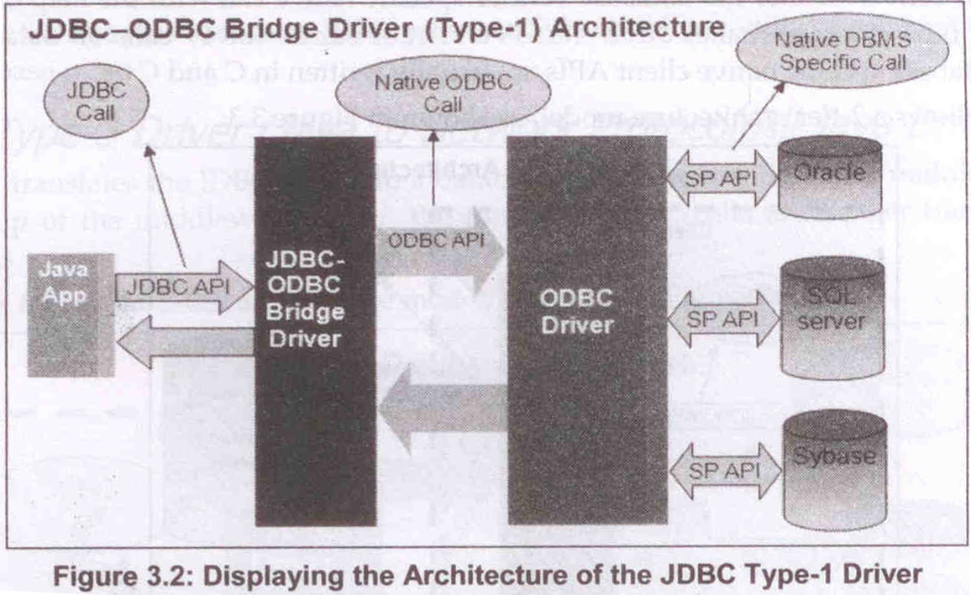
JDBC - Type 1 Driver

Slide 6
JDBC - Type 1 Driver - Advantages
Represents Single Driver implementation to interact with different data stores.
Allows us to communicate with all the databases supported by the ODBC Driver.
Represents a vendor independent Driver.

Slide 7
JDBC - Type 1 Driver - Disadvantages
Decreases the execution speed due to a large number of translation.
Depends on the ODBC driver; and therefore, Java applications also become indirectly dependent on ODBC drivers.
Requires the ODBC binary code or ODBC client library that must be installed on every client.
Use Java Native Interface(JNI) to make ODBC calls.

Slide 8
JDBC - Type 2 Driver (Java to Native API)
The Java application makes the JDBC call to the Type-2 driver.
The JDBC calls are converted into database specific native calls in the client machine and the request is then dispatched to the database specific native library.
Through Native Protocols the request is sent to the Database server.
Not Recommended to use it with Client-Side Applications. As it can work like 2-tier arch.

Slide 9
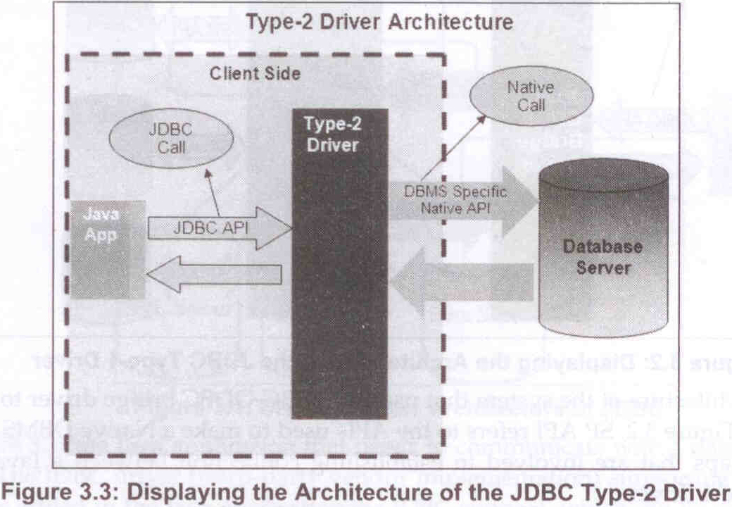
JDBC - Type 2 Driver (Java to Native API)

Slide 10
JDBC - Type 2 Driver - Advantages
Helps to access the data faster as compare to other types of drivers.
Contains additional features provided by the specific database vendor, which are also supported by the JDBC specification.

Slide 11
JDBC - Type 2 Driver - Disadvantages
Requires native libraries to be installed on client machines, since the conversion from JDBC calls to database specific native calls is done on client machines.
Executes the database specific native functions on the client JVM, implying that any bug in the Type-2 driver might crash the JVM
Increases the cost of the application in case it is run on different platforms.

Slide 12
JDBC - Type 2 Driver - Examples
OCI (Oracle Call Interface) Driver – Communicates with the Oracle database server. This driver converts JDBC calls into Oracle Native Library calls.
Weblogic OCI Driver for Oracle – Makes JNI calls to weblogic library functions.
Type-2 Driver for Sybase – Converts JDBC calls into Sybase dblib or ctlib calls, which are native libraries to connect to Sybase.

Slide 13
JDBC - Type 3 Driver (Java to Network Protocol/All Java Driver)
Type-3 Driver listens to the JDBC calls from Java applications and translate them into middleware server specific calls.
The driver communicates with the middleware server over a socket.
The middleware server converts these calls into database specific calls.
Recommended to use it with Applet like Applications as the drivers are auto Downloadable.

Slide 14
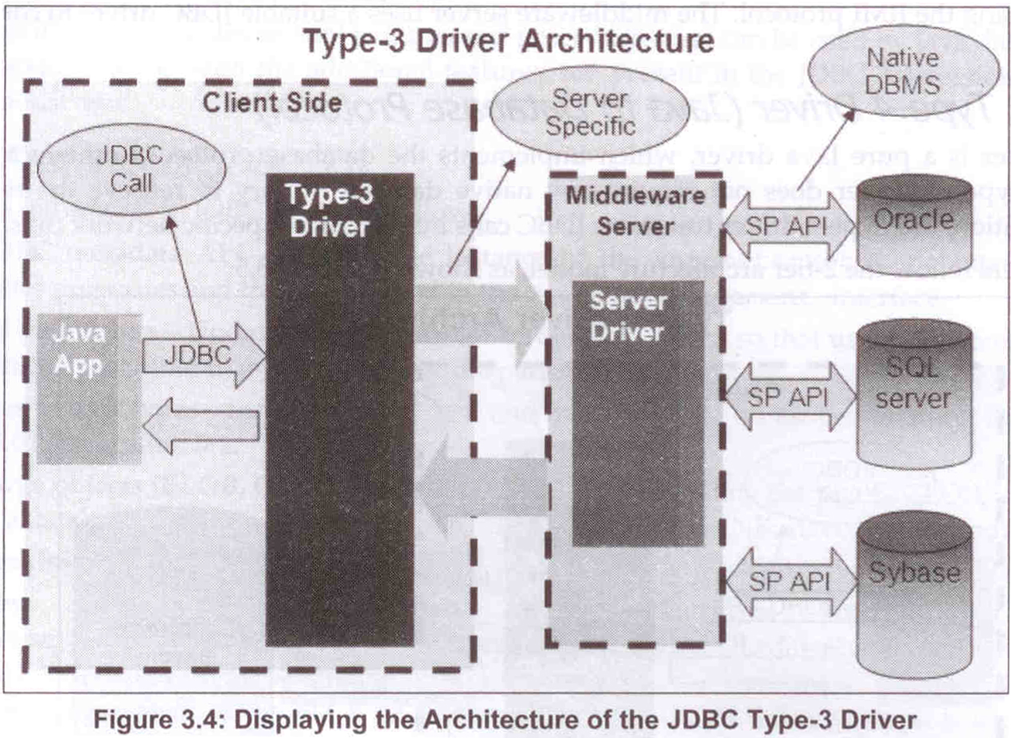
JDBC - Type 3 Driver (Java to Network Protocol/All Java Driver)

Slide 15
JDBC - Type 3 Driver - Advantages
Serves as a all Java driver and is auto Downloadable.
Does not require any native library to be installed on the client machine.
Ensures database independency, because a single driver provides accessibility to different types of databases.
Does not provide the database details, such as UN, PW, SrvrLocatn to the Client, it is managed on the middleware.
Facility to switch ovr from one DB to another without changing the client-side driver.

Slide 16
JDBC - Type 3 Driver - Disadvantages
Main disadvantage of the Type-3 driver is that it performs the tasks slowly due to the increased number of network calls as compared to Type-2 drivers.
This driver is costlier as compared to other drivers.

Slide 17
JDBC - Type 3 Driver - Examples
IDS Driver – Listen for JDBC calls and converts them into IDS Server specific network calls. The type-3 driver communicates over a socket to IDS server, which acts as middleware server.
Weblogic RMI Driver – Listens for JDBC calls and sends the request from the client to the middleware server by using the RMI protocol. The middleware server uses a suitable JDBC driver to communicate with a database.

Slide 18
JDBC - Type 4 Driver
(Java Database Protocol)
The Type-4 driver prepares a DBMS specific network message and then communicates with database server over a socket.
This type of driver is lightweight and generally known as a thin driver.
The Type-4 driver uses database specific proprietary protocols for communication.
Generally this type of driver is implemented by DBMS vendors.

Slide 19
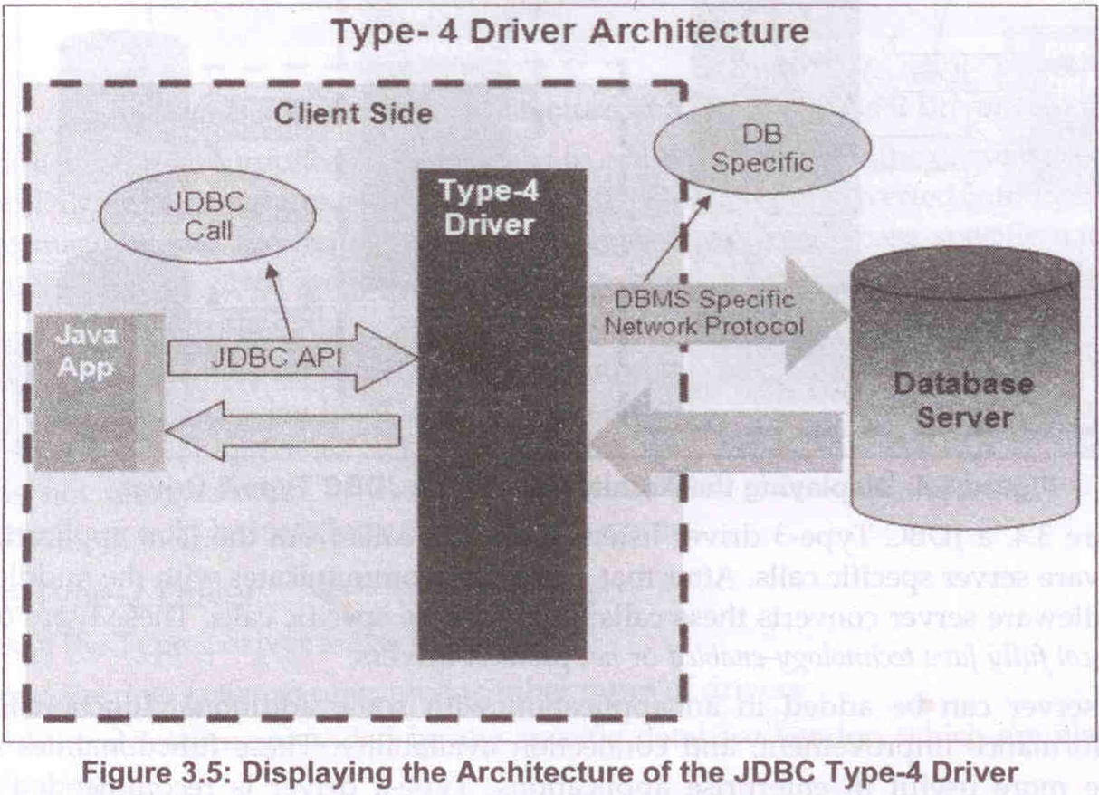
JDBC - Type 4 Driver
(Java Database Protocol)

Slide 20
JDBC - Type 4 Driver - Advantages
Serves as a pure Java driver and is auto downloadable.
Does not require any native library to be installed on the client machine.
Uses database server specific protocol.
Does not require a middleware server.

Slide 21
JDBC - Type 4 Driver - Disadvantages
It uses database specific proprietary protocol and is DBMS vendor dependent.

Slide 22
JDBC - Type 4 Driver - Examples
Thin Driver for Oracle from Oracle Corporation
Weblogic and Mssqlserver4 for MS SQL server from BEA systems

Slide 23
Changing Port 4 Oracle 10g
C:\>sqlplus /nolog
SQL*Plus: Release 10.2.0.1.0 - Production on Tue Aug 26 10:40:44 2008
Copyright (c) 1982, 2005, Oracle. All rights reserved.
SQL> connect
Enter user-name: system
Enter password: <enter password if will not be visible>
Connected.
SQL> Exec DBMS_XDB.SETHTTPPORT(8087); [Assuming you want to have HTTP going to this port]
PL/SQL procedure successfully completed.
SQL>quit
Disconnected from Oracle Database 10g Express Edition Release 10.2.0.1.0 - Production

Slide 24
Changing Port 4 Tomcat
Locate server.xml in {Tomcat installation folder}\ conf \
Find following similar statement
<!-- Define a non-SSL HTTP/1.1 Connector on port 8180 --> <Connector port="8080" maxHttpHeaderSize="8192" maxThreads="150" minSpareThreads="25" maxSpareThreads="75" enableLookups="false" redirectPort="8443" acceptCount="100" connectionTimeout="20000" disableUploadTimeout="true" />
Or
<!-- A "Connector" represents an endpoint by which requests are received and responses are returned. Documentation at : Java HTTP Connector: /docs/config/http.html (blocking & non-blocking) Java AJP Connector: /docs/config/ajp.html APR (HTTP/AJP) Connector: /docs/apr.html Define a non-SSL HTTP/1.1 Connector on port 8080 --> <Connector port="8080" protocol="HTTP/1.1" connectionTimeout="20000" redirectPort="8443" />
3) About Tomcat’s server.xml file cites it’s runs on port 8080. Change the Connector port=”8080″ port to any other port number.
For example
  <Connector port="8181" protocol="HTTP/1.1" connectionTimeout="20000" redirectPort="8443" />

Slide 25
Changing Port 4 GlassFish
Find out the folder where GlassFish is installed.If you installed GlassFish along with NetBeans, you can find out the folder where GlassFish is installed by using the following procedure.
Select Services window by using Window -> Services in NetBeans IDE
Expand Servers node and select GlassFish Domain
Right click and select Properties option from popup menu.
On the right of Domains Folder you can see the folder where GlassFish is installed. For example : C:\netbeans6.8\glassfish-v3\glassfish\domains. You can also see the other details regarding Glassfish such as port number, in the same window.
Go to the folder where Glassfish in installed.Go into config folder which is as follows: c:\netbeans6.8\glassfish-3\glassfish\domains\domain1\configOpen domain.xml using any text editor.Look for 8080 and change it to some other port number that doesn’t conflict with other port numbers. I generally change it to 9999.Save domain.xml.Now you need to remove GlassFish from NetBeans and add it again so that NetBeans IDE understands the new port number. For this do the following:In Servers window of NetBeans, remove GlassFish by using RemoveServer button after selecting GlassFish server.
Click on AddServer and select GlassFish V2 or GlassFish V3 and click on Next.
Select the Installation Location of GlassFish and click on Next.
Accept defaults and click on Finish.
Restart GlassFish, if it was already running.

Slide 26
Changing Port XAMP Server
Stop the XAMPP server, if it is running already.
Open the file [XAMPP Installation Folder]/apache/conf/httpd.conf.
Now search for the string Listen 80 (I’m assuming that your XAMPP was using the port 80. Otherwise, just search for the string “Listen”). This is the port number which XAMPP uses. Change this 80 to any other number which you prefer.
Then search for the string “ServerName” and update the port number there also.
Now save and re-start XAMPP server and you are done.

Slide 27
Different Driver List
IBM DB2
jdbc:db2://<HOST>:<PORT>/<DB>
COM.ibm.db2.jdbc.app.DB2Driver
JDBC-ODBC Bridge
jdbc:odbc:<DB>
sun.jdbc.odbc.JdbcOdbcDriver
Microsoft SQL Server
jdbc:weblogic:mssqlserver4:<DB>@<HOST>:<PORT>
weblogic.jdbc.mssqlserver4.Driver
Oracle Thin
jdbc:oracle:thin:@<HOST>:<PORT>:<SID>
oracle.jdbc.driver.OracleDriver
PointBase Embedded Server
jdbc:pointbase://embedded[:<PORT>]/<DB>
com.pointbase.jdbc.jdbcUniversalDriver
Cloudscape
jdbc:cloudscape:<DB>
COM.cloudscape.core.JDBCDriver
Cloudscape RMI
jdbc:rmi://<HOST>:<PORT>/jdbc:cloudscape:<DB>
RmiJdbc.RJDriver
Firebird (JCA/JDBC Driver)
jdbc:firebirdsql:[//<HOST>[:<PORT>]/]<DB>
org.firebirdsql.jdbc.FBDriver
IDS Server
jdbc:ids://<HOST>:<PORT>/conn?dsn='<ODBC_DSN_NAME>'
ids.sql.IDSDriver
Informix Dynamic Server
jdbc:informix-sqli://<HOST>:<PORT>/<DB>:INFORMIXSERVER=<SERVER_NAME>
com.informix.jdbc.IfxDriver
InstantDB (v3.13 and earlier)
jdbc:idb:<DB>
jdbc.idbDriver
InstantDB (v3.14 and later)
jdbc:idb:<DB>
org.enhydra.instantdb.jdbc.idbDriver
Interbase (InterClient Driver)
jdbc:interbase://<HOST>/<DB>
interbase.interclient.Driver
Hypersonic SQL (v1.2 and earlier)
jdbc:HypersonicSQL:<DB>
hSql.hDriver
Hypersonic SQL (v1.3 and later)
jdbc:HypersonicSQL:<DB>
org.hsql.jdbcDriver
Microsoft SQL Server (JTurbo Driver)
jdbc:JTurbo://<HOST>:<PORT>/<DB>
com.ashna.jturbo.driver.Driver
Microsoft SQL Server (Sprinta Driver)
jdbc:inetdae:<HOST>:<PORT>?database=<DB>
com.inet.tds.TdsDriver
Microsoft SQL Server 2000 (Microsoft Driver)
jdbc:microsoft:sqlserver://<HOST>:<PORT>[;DatabaseName=<DB>]
com.microsoft.jdbc.sqlserver.SQLServerDriver
MySQL (MM.MySQL Driver)
jdbc:mysql://<HOST>:<PORT>/<DB>
org.gjt.mm.mysql.Driver
Oracle OCI 8i
jdbc:oracle:oci8:@<SID>
oracle.jdbc.driver.OracleDriver
Oracle OCI 9i
jdbc:oracle:oci:@<SID>
oracle.jdbc.driver.OracleDriver
PostgreSQL (v6.5 and earlier)
jdbc:postgresql://<HOST>:<PORT>/<DB>
postgresql.Driver
PostgreSQL (v7.0 and later)
jdbc:postgresql://<HOST>:<PORT>/<DB>
org.postgresql.Driver
Sybase (jConnect 4.2 and earlier)
jdbc:sybase:Tds:<HOST>:<PORT>
com.sybase.jdbc.SybDriver
Sybase (jConnect 5.2)
jdbc:sybase:Tds:<HOST>:<PORT>
com.sybase.jdbc2.jdbc.SybDriver
//To test your driver once it's installed, try the following code:
Class.forName("Driver name");
Connection con = DriverManager.getConnenction("jdbcurl","username","password");
Notes:
IBM DB2
jdbc:db2://<HOST>:<PORT>/<DB>
COM.ibm.db2.jdbc.app.DB2Driver
JDBC-ODBC Bridge
jdbc:odbc:<DB>
sun.jdbc.odbc.JdbcOdbcDriver
Microsoft SQL Server
jdbc:weblogic:mssqlserver4:<DB>@<HOST>:<PORT>
weblogic.jdbc.mssqlserver4.Driver
Oracle Thin
jdbc:oracle:thin:@<HOST>:<PORT>:<SID>
oracle.jdbc.driver.OracleDriver
PointBase Embedded Server
jdbc:pointbase://embedded[:<PORT>]/<DB>
com.pointbase.jdbc.jdbcUniversalDriver
Cloudscape
jdbc:cloudscape:<DB>
COM.cloudscape.core.JDBCDriver
Cloudscape RMI
jdbc:rmi://<HOST>:<PORT>/jdbc:cloudscape:<DB>
RmiJdbc.RJDriver
Firebird (JCA/JDBC Driver)
jdbc:firebirdsql:[//<HOST>[:<PORT>]/]<DB>
org.firebirdsql.jdbc.FBDriver
IDS Server
jdbc:ids://<HOST>:<PORT>/conn?dsn='<ODBC_DSN_NAME>'
ids.sql.IDSDriver
Informix Dynamic Server
jdbc:informix-sqli://<HOST>:<PORT>/<DB>:INFORMIXSERVER=<SERVER_NAME>
com.informix.jdbc.IfxDriver
InstantDB (v3.13 and earlier)
jdbc:idb:<DB>
jdbc.idbDriver
InstantDB (v3.14 and later)
jdbc:idb:<DB>
org.enhydra.instantdb.jdbc.idbDriver
Interbase (InterClient Driver)
jdbc:interbase://<HOST>/<DB>
interbase.interclient.Driver
Hypersonic SQL (v1.2 and earlier)
jdbc:HypersonicSQL:<DB>
hSql.hDriver
Hypersonic SQL (v1.3 and later)
jdbc:HypersonicSQL:<DB>
org.hsql.jdbcDriver
Microsoft SQL Server (JTurbo Driver)
jdbc:JTurbo://<HOST>:<PORT>/<DB>
com.ashna.jturbo.driver.Driver
Microsoft SQL Server (Sprinta Driver)
jdbc:inetdae:<HOST>:<PORT>?database=<DB>
com.inet.tds.TdsDriver
Microsoft SQL Server 2000 (Microsoft Driver)
jdbc:microsoft:sqlserver://<HOST>:<PORT>[;DatabaseName=<DB>]
com.microsoft.jdbc.sqlserver.SQLServerDriver
MySQL (MM.MySQL Driver)
jdbc:mysql://<HOST>:<PORT>/<DB>
org.gjt.mm.mysql.Driver
Oracle OCI 8i
jdbc:oracle:oci8:@<SID>
oracle.jdbc.driver.OracleDriver
Oracle OCI 9i
jdbc:oracle:oci:@<SID>
oracle.jdbc.driver.OracleDriver
PostgreSQL (v6.5 and earlier)
jdbc:postgresql://<HOST>:<PORT>/<DB>
postgresql.Driver
PostgreSQL (v7.0 and later)
jdbc:postgresql://<HOST>:<PORT>/<DB>
org.postgresql.Driver
Sybase (jConnect 4.2 and earlier)
jdbc:sybase:Tds:<HOST>:<PORT>
com.sybase.jdbc.SybDriver
Sybase (jConnect 5.2)
jdbc:sybase:Tds:<HOST>:<PORT>
com.sybase.jdbc2.jdbc.SybDriver
//To test your driver once it's installed, try the following code:
Class.forName("Driver name");
Connection con = DriverManager.getConnenction("jdbcurl","username","password");

Slide 28
Reference Books:
Java Server Programming For Professionals
  – By Ivan Bayross & Sharanam Shah
  Shroff publication
Java Server Programming Black Book
  – Dreamtech Publications

